Slide 1
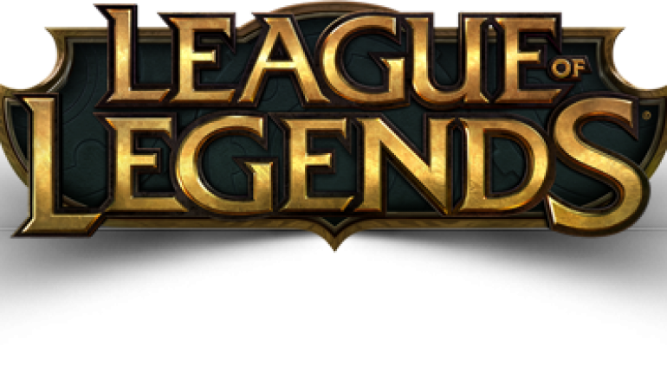
League of legends
League of legends is an Multiplayer Online Battle Arena Game, many MOBA’s that exist on the smartphone right now are based on LoL or Dota. Most concepts apply to the mobile game versions of this game.

Slide 2
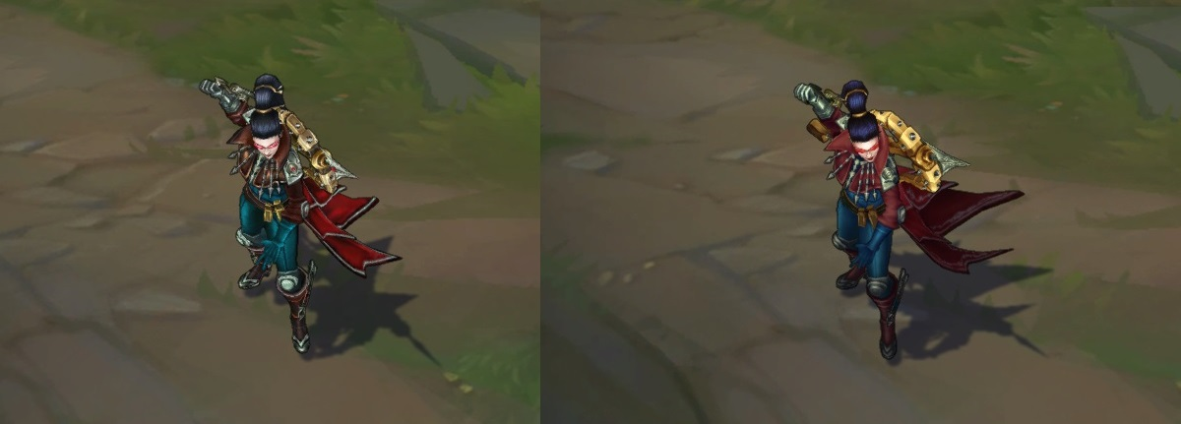
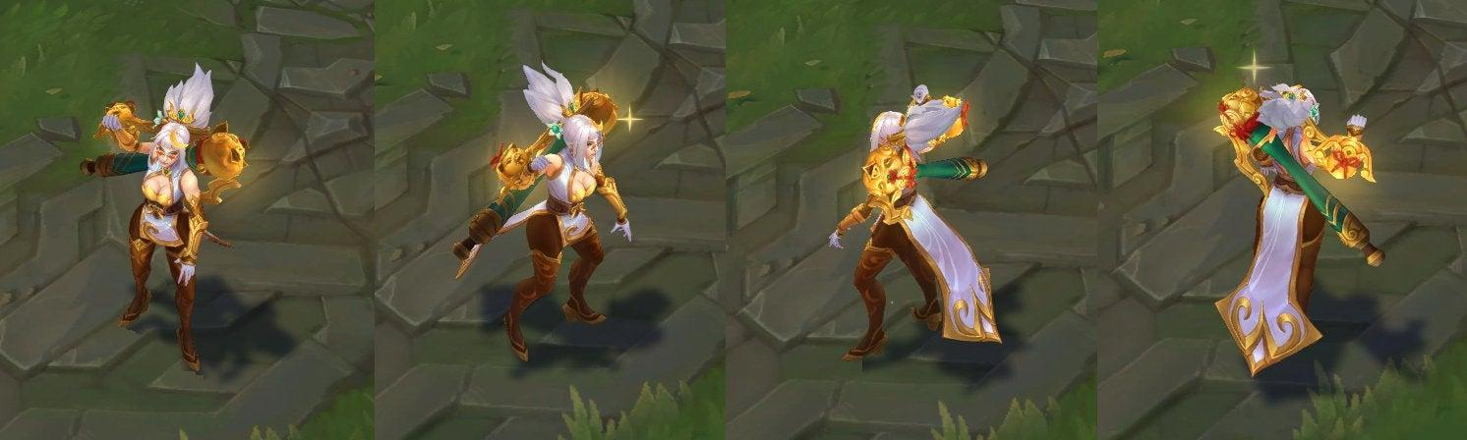
Problem
Dominant strategies (Metas) exist as a result of the lack of game balance and theory
Many factors contribute to the imbalance of a game such as powering champions, game objectives, etc
A game’s major goal is to be profitable and companies may have prioritized this, which may be a factor to imbalances in games
Difficult to minimize game imbalance due to the complexity and asymmetry of the game
Unsatisfactory user experience
Original Champion
Champion with new Skin

Slide 3
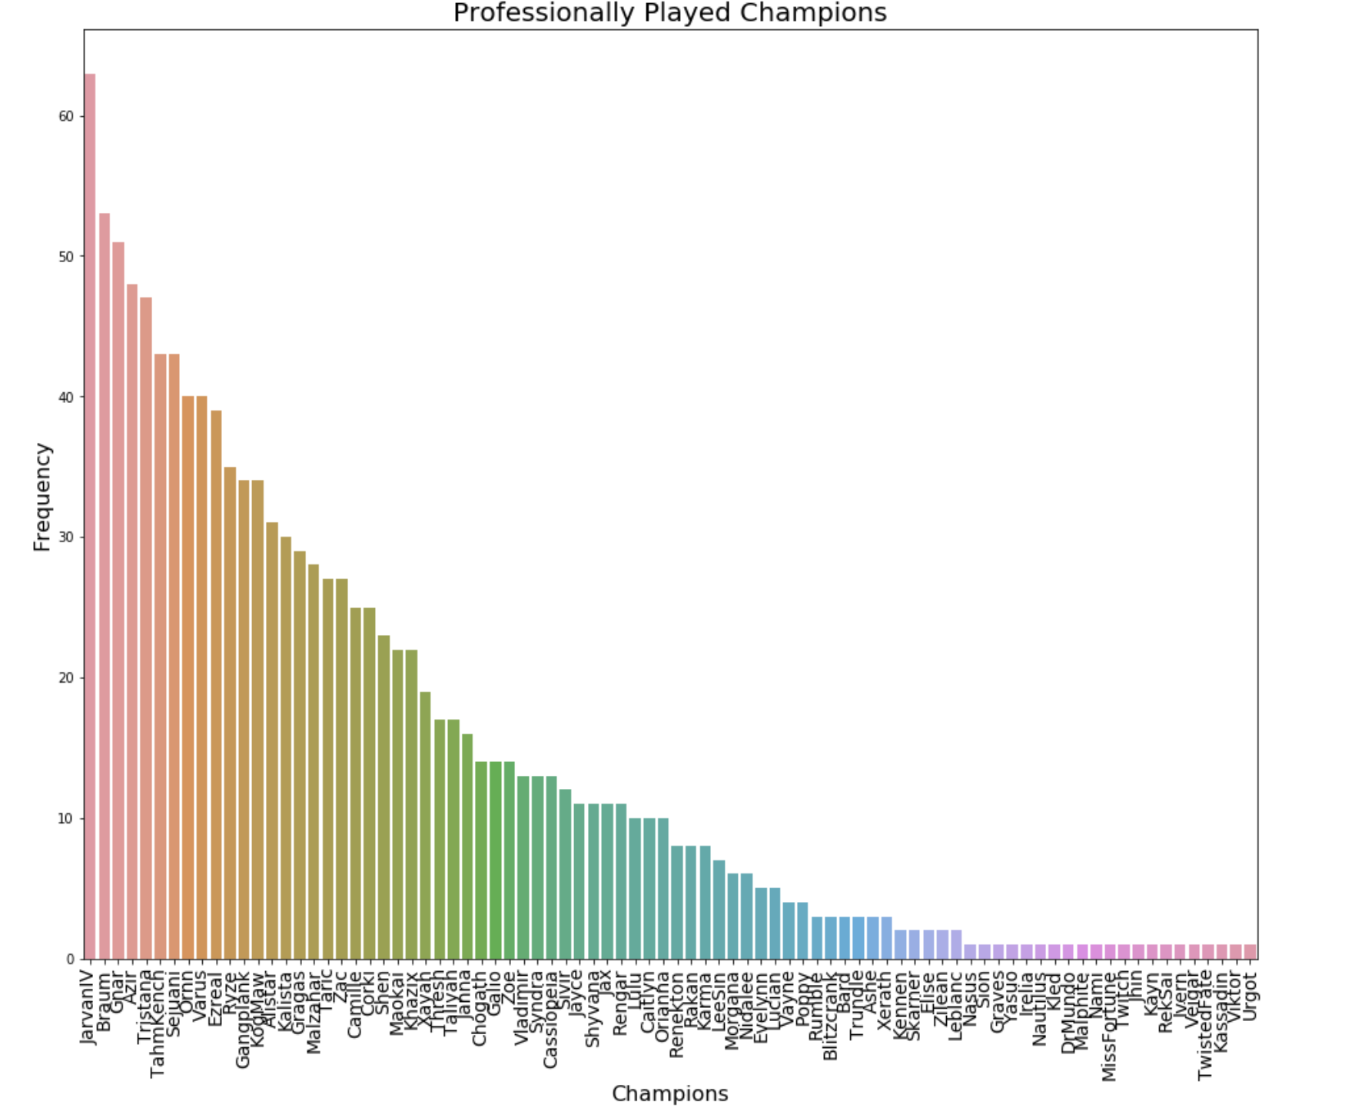
2018 Spring Split

Slide 4
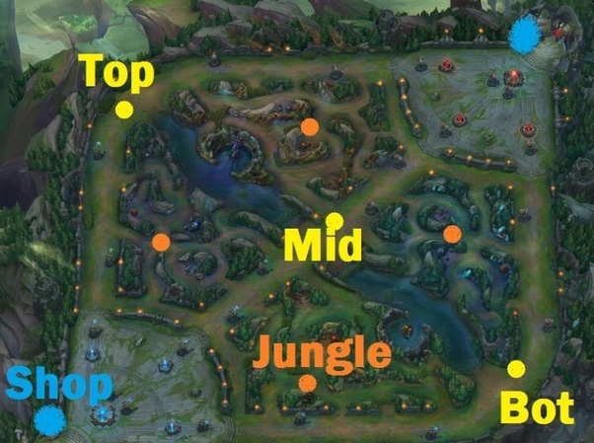
Data Investigation
Patch updates and the aftereffects to champion win-rate, pick-rate, ban-rate
Dive deeper into new skin release, champion rework, new champion releases, buffs and nerfs
Conduct above analysis but break down to particular roles
Damage and Resource ratio
This observes the allocation of resources and whether a champion is doing too much when it’s getting a small portion of the resources
New release life cycle to understand when a nerf should come in
Apply and Calculate Metagame Bounds

Slide 5

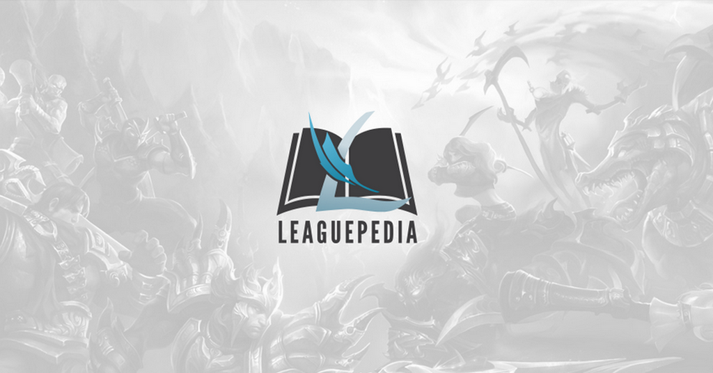
Data Sources
Historical champion win-rate, pick-rate, ban-rate data is not easy to obtain
After some research many onlines sources like op.gg only provide previous month historical statistics, which will prevent us from monitoring and learning from historical data
Getting data directly from Riot API portal (2014)
Data is going to be large and we can’t pull every game
Develop some sort of random or stratified sampling method
High Tier vs Low Tier Games
Scraping data from the web for patch updates and champion release dates
Create parser to map data to simpler forms (Patch updates can be complicated)

Slide 6
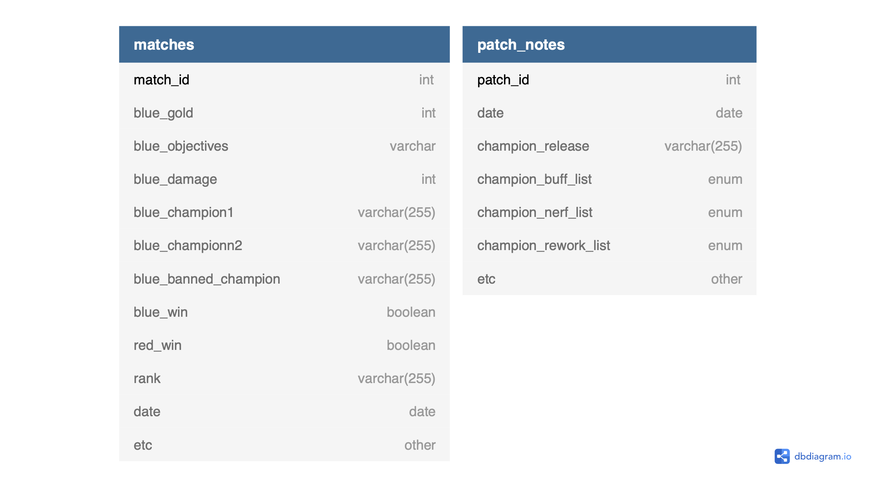
Database Schema

Slide 7
A/B Testing
A/B testing population could be the same users that play both on beta and usual server
Same users to keep population close to identical
Mobile game (two versions)
Metrics to include would be the champion win-rate, ban-rate, pick-rate
Changes to make would be small tweaks in champions either nerf or buff
Bayesian vs Frequentist approach
When to lock in results?

Slide 8
Solutions and Recommendations
Nerf champions
High win rate, pick rate, ban rate
Nerf items that are strong for particular roles
Test out small tweaks A/B Test
Buff champions
Buff counter champions
infinite loop, develop process to rework older champions
Understand new champion release life cycle and how fast it affects win-rate
Collaborate with pro gamers/high rank players to understand game tactics and use them as game testers before release

